Slide 1
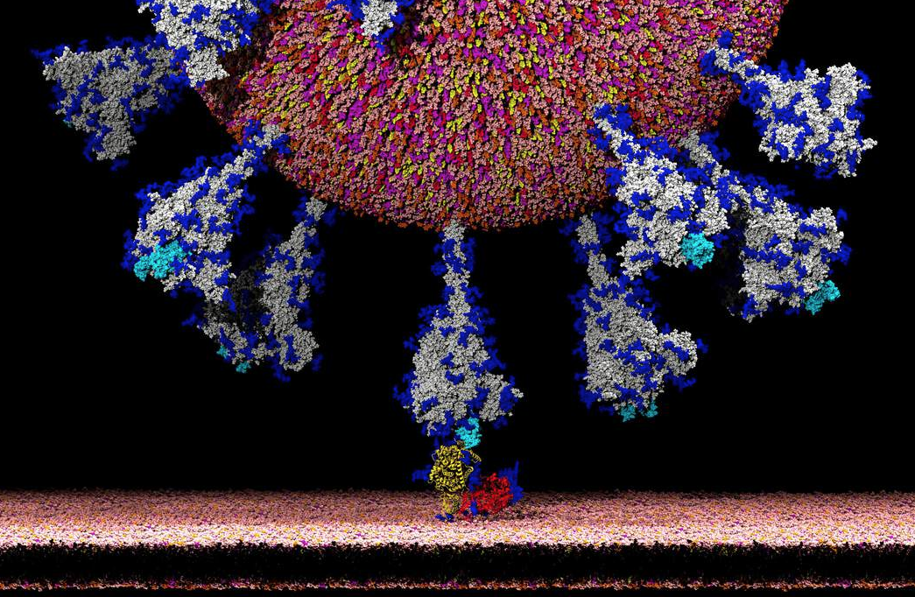
Image:
New York Times

Slide 2

Breathe
Credit: Heather Bussing

Slide 3
How HR (and Tech)
Can Address Workplace Health and Safety
John Sumser
Fall 2020

Slide 4

Real Transformation
“This is how systems change actually happens. Many contexts are simultaneously shifting in increasing rapid response to other changes. Logic & structures of old patterns are dissolving in response to response to response- within personal, societal & ecological complex systems. All at once.”
Nora Bateson

Slide 5
Sustained Traumatic Stress
“Some typical civilian stressors include
- life threat;
being confined to one's home;
losing a loved one or family member;
suffering from financial hardships; and
having restricted access to resources such as food, water, and other supplies.”
https://www.ptsd.va.gov/professional/treat/specific/combat_stress_civilian.asp
Photo by steve pancrate on Unsplash
Notes:
Photo by steve pancrate on Unsplash

Slide 6
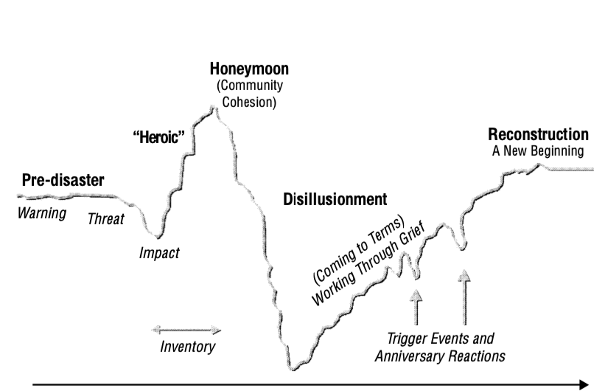
Psychological Reactions to Disaster
We are here
March 11
Until
Now
March 11
Time
From Field Manual for Mental Health and Human Service Workers in Major Disasters https://www.hsdl.org/?view&did=4017

Slide 7
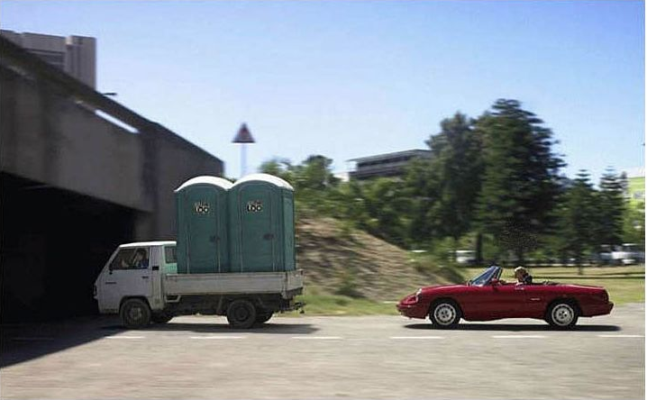
Heroic Response to Sustained Trauma
Engagement scores up
Suicide up 30%
Predictable crash is coming
Revenue and margin success
Anti-depressant sales skyrocket
Elimination of healthy boundaries
Not new, normal, or sustainable

Slide 8

Expect New Disabilities and New Safety Issues
Repetitive Mental Stress Disorders
60% of COVID survivors have heart issues
Heavy lung compromise
COVID impact on judgement
Increased anti-depressant consumption
Alcohol and drugs
Complex sustained trauma syndromes
Risk aversion
Photo by Callie Gibson on Unsplash

Slide 9
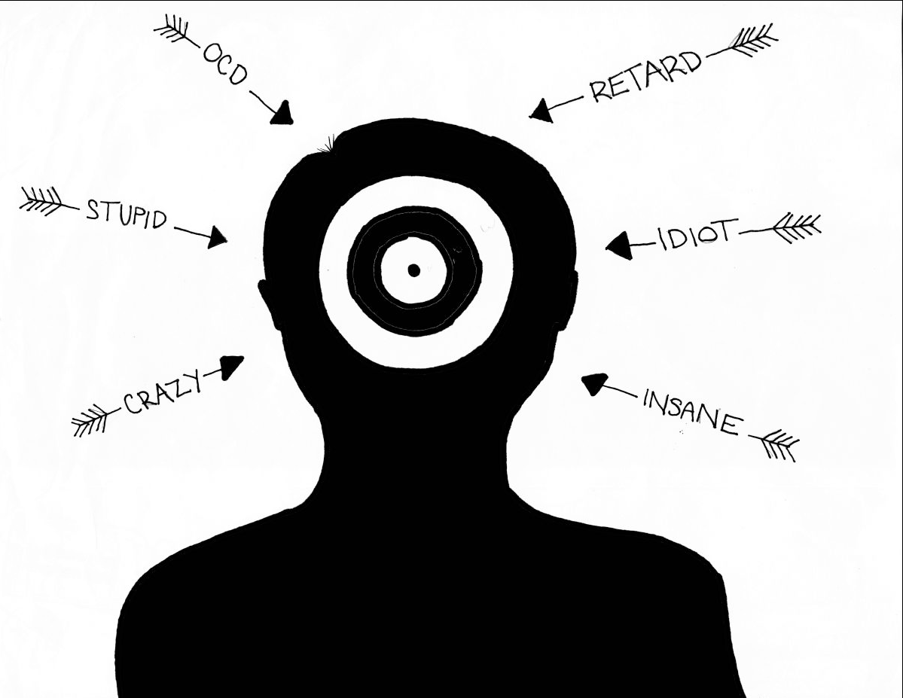
Mental illness: removing the stigma
Image: redwoodbark.org

Slide 10
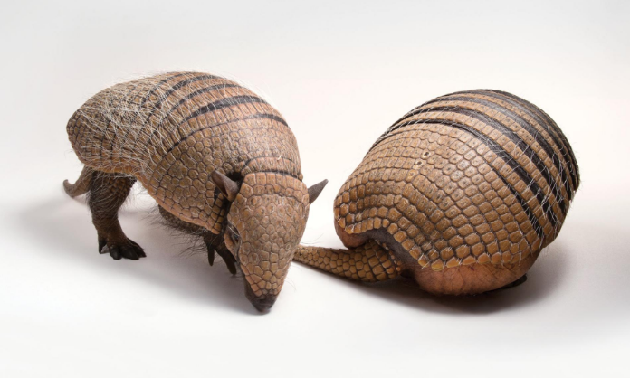
Key Organizational Changes
Pre Covid
2.9 Close relationships
40 2nd order relationships
Covid
7 Close relationships
15 2nd order relationships
Long term consequences
Unclear
Source: Humanyze

Slide 11

Question, Experiment, and Improve
Intense ambiguity and uncertainty ahead
Photo by Katie Moum on Unsplash

Slide 12
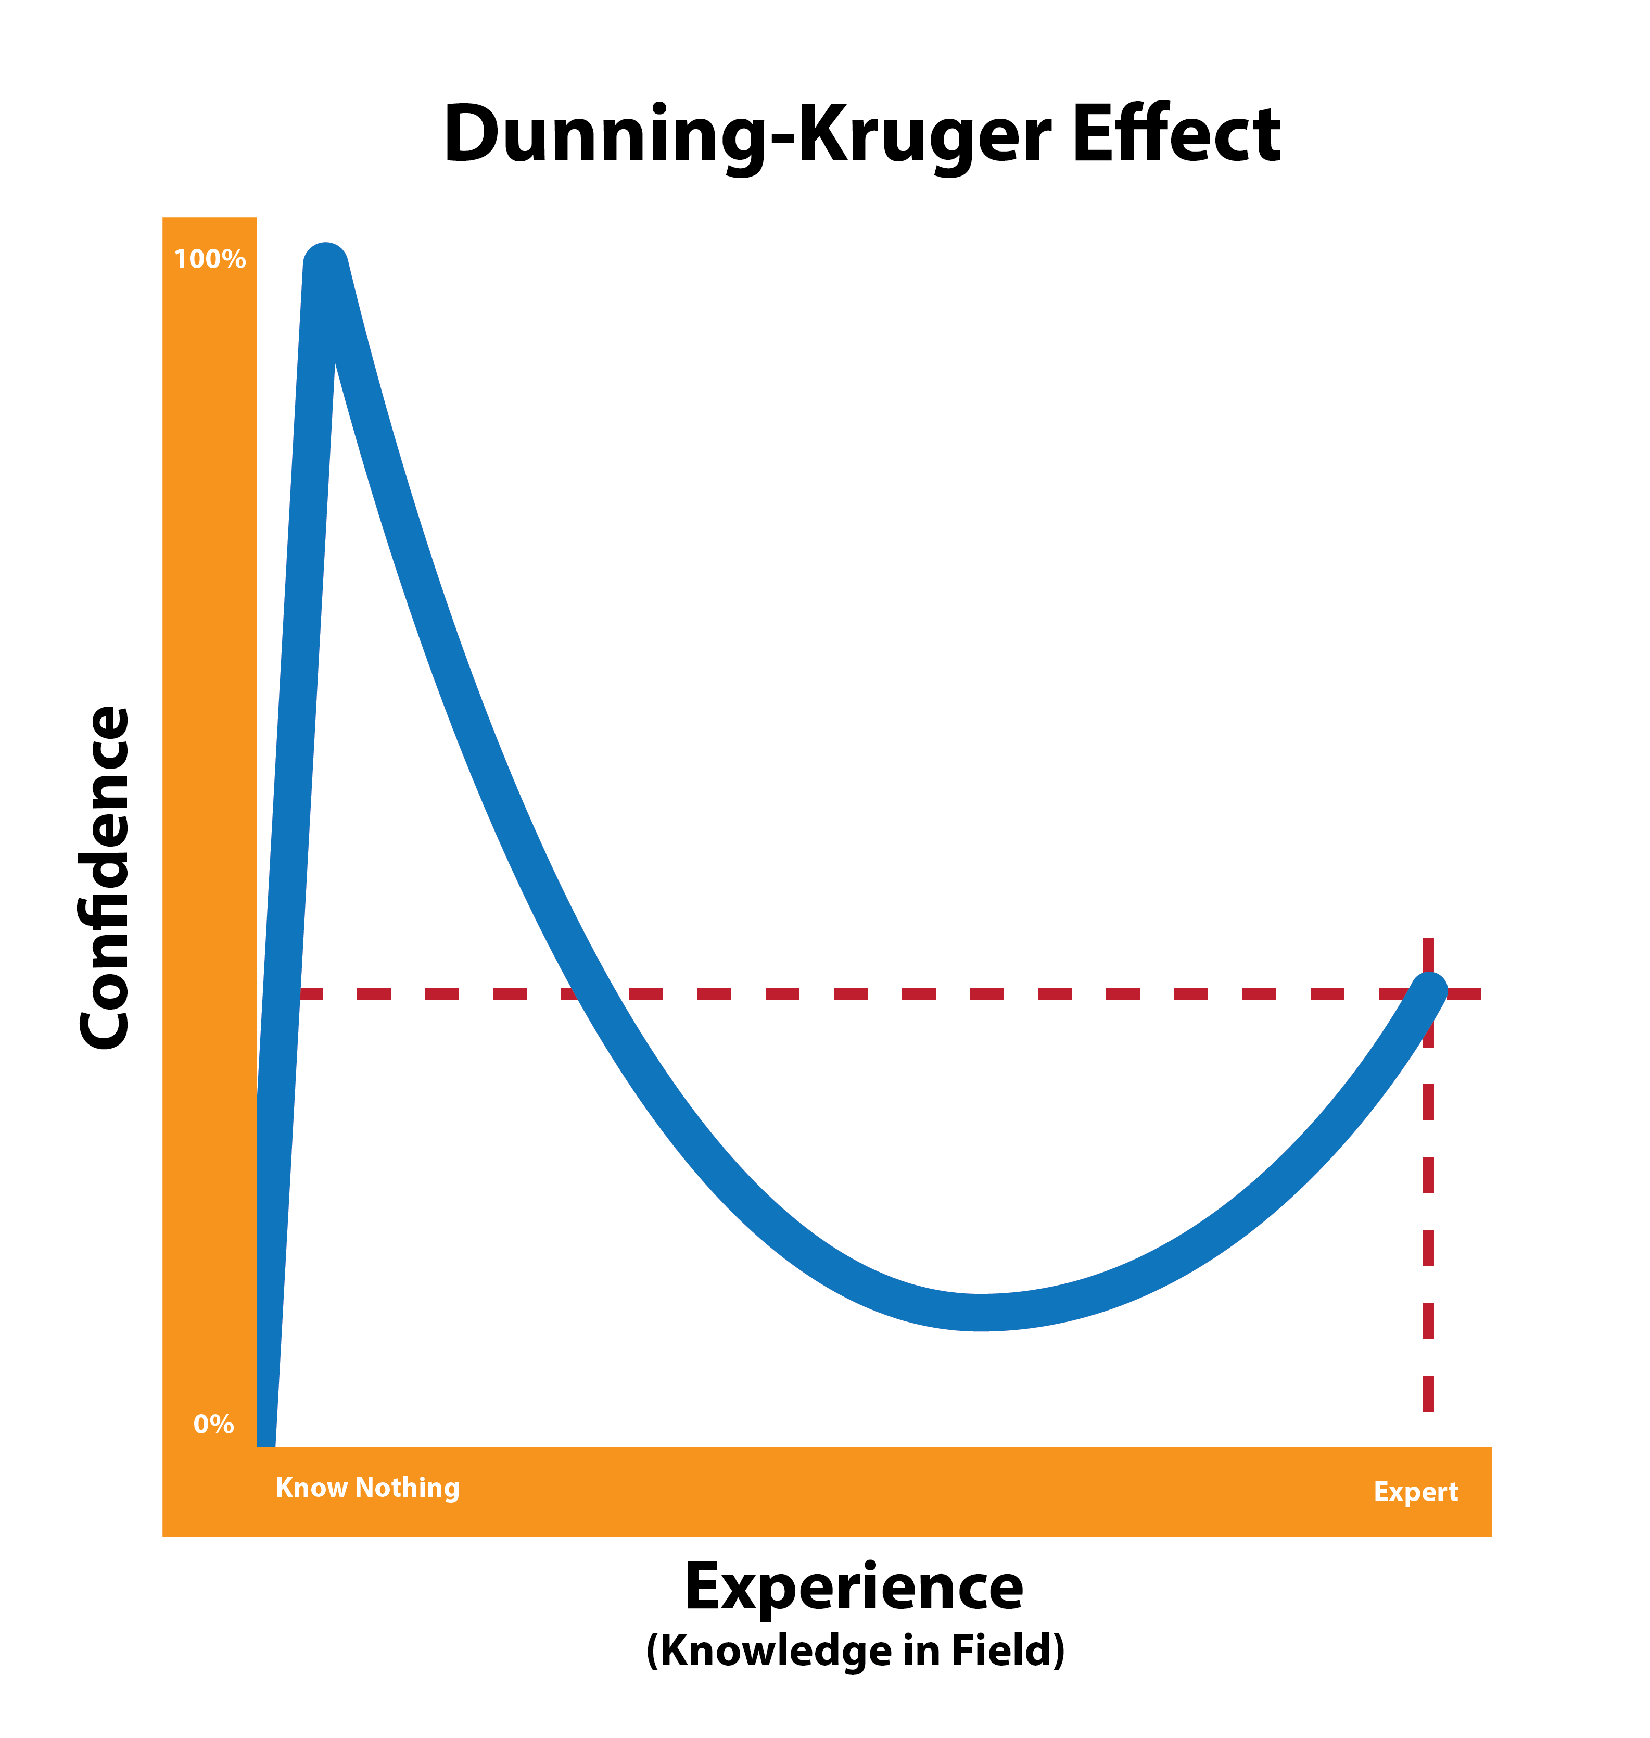
Beware of Certainty

Slide 13

Breathe
Credit:
Heather
Bussing
Breathe

Slide 14
In the transition from factory to office, the importance of safety diminished. The pandemic restores it to the primary HR function
Development
3
Health
2
Safety
1

Slide 15

The Facets of S, H, and D
Physical
Emotional
Mental
Spiritual (Values)
Financial
Environmental
Occupational
Social

Slide 16
Goals
Safety
Health
Development
Minimize:
Physical Danger
Harassment
Discrimination
Exclusion
Bias
Unnecessary Stress
Optimize:
Sense of Control
Reciprocation
Merit
Inclusion
Shared Values
Relaxation
Competence
Improve:
Autonomy
Group Coherence
Fulfillment
Equity
Community
Equanimity
Professional Growth
Organizational Agility

Slide 17

Organizational Safety, Health, and Development
Exploration
Collaboration
Adaptability
Alignment
Tech Infrastructure
Adequate Tooling
Network Function
Connection
Diversity
Belongingness
Market Fitness
Organizational SHD is not the aggregate of employee SHD

Slide 18

What is Organizational Health?
Network Robustness
Freedom from operational degradation
Continuous improvement
Ease of integration (new employees)
Ease of transition
Smooth response to disruptions
Appropriate margins and growth
Improving trust
Adequate resource distribution
Employee Safety, Health and Development
Effective People Analytics
Photo by Edgar Castrejon on Unsplash

Slide 19

The organization has a voice
Photo by Jason Rosewell on Unsplash
Photo by Jason Rosewell on Unsplash

Slide 20

New SHD Risks
Employee SHD is a demonstration of trust
Pandemic related burnout
Inadequate serendipity
Mistaking accomplishment for okayness
Creeping mental health issues
Flawed information governance
Reliance on old models of the office
Misunderstanding analytics
Photo by Justus Menke on Unsplash

Slide 21
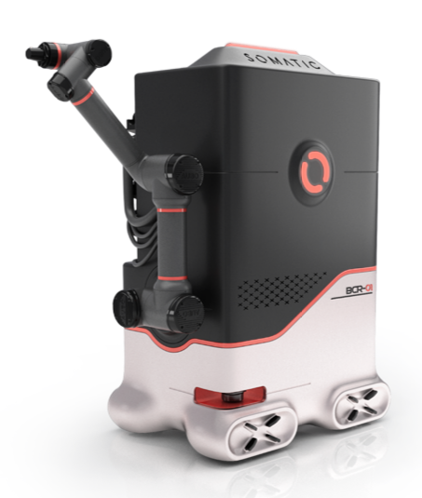
New SHD Technology
Pathfindr: Beeping wearable to enforce social distancing
Vodafone: Heat sensing camera for entrances
Google/Apple: Contact tracing systems
M2SYS: RightPunch™ Touchless time clock
Idshop: proximity badges and wristbands
Kronos: InTouch DX biometric time clock
ServiceNow: Reservation system
Somatic: Bathroom cleaning robot
Leviton: Occupancy Sensor

Slide 22
What about the rest of HR?
Payroll and Benefits are the cornerstones of safety
Recruiting works better when the organization is healthy
Talent Management is a part of development
Learning is a part of safety, health, and development
The priorities are rearranged. The component parts are similar.

Slide 23

What’s missing
Safety, Health, and Development forecasting
Real-time risk identification at a system level
Clear linkage between individual and organizational S,H, & D
Frameworks for thinking about sentiment
Better understanding of the consequences of sustained trauma

Slide 24
Who’s doing amazing stuff (the Watchlist)
Workday: Return to work tools
ServiceNow: Return to work tools
ADP: AI Ethics Board
Socrates.ai: Information governance
Humanyze: Organizational Health Score
Vizier: Integrating COVID and operational data
PhenomPeople: Broad spectrum intelligent automation
Greenhouse: Focus on good decisions
HiringSolved: Search as the primary HR problem
WorkforceLogiq: Diversity maps and forecast
Organization View: Reducing the need for data scientists
Culture Amp: Rethinking the meaning of engagement scores
Arena.io: Moving people from one industry to another
Notes:
:

Slide 25

Breathe
Breathe
Credit:
Heather
Bussing

Slide 26

Ethics is a conversation
At its simplest, ethics is asking questions like:
What could go possibly wrong?
What is the right thing to do?
Will this hurt anyone?
Can we improve things?
Where are our biases?
Photo by Jason Leung on Unsplash

Slide 27

In the era of intelligent tools (AI), an ethics process is the foundation of safety and health.

Slide 28
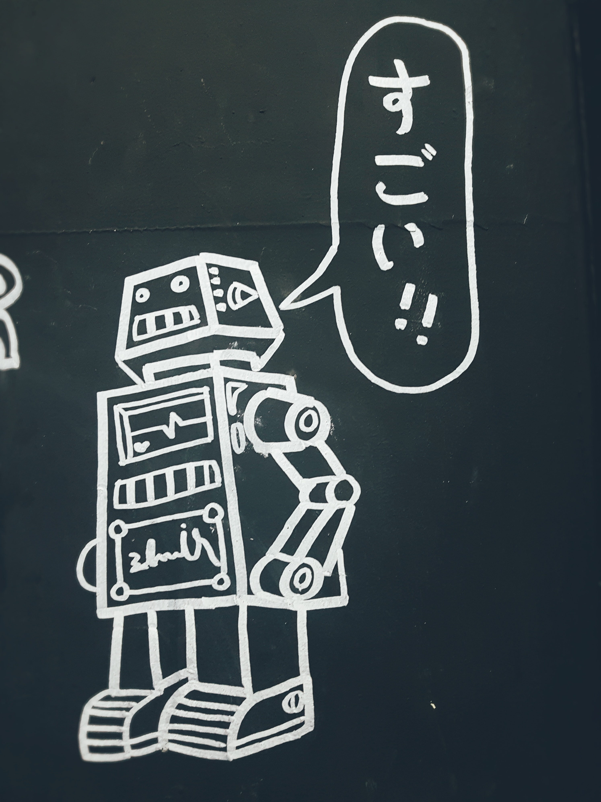
We are in new circumstances; Every decision is a first.
All decisions have unintended consequences.

Slide 29
All HR Departments and their vendors need an operational ethics function.
Creates accountability
Ensures awareness of bias
Expands effectiveness
Improves planning
Minimizes unintended consequences
Improves safety and health
Insulates against insularity
The heart of a continuously learning organization
Models handling uncertainty and ambiguity

Slide 30
Why safety is an ethics question
Mental health and safety in the home office
Balancing individual and organizational risk
Attestation vs asymptomatic risk
Balancing business continuity and physical safety
Data collection potentially creates PII
Forces the ‘what could go wrong here question’

Slide 31
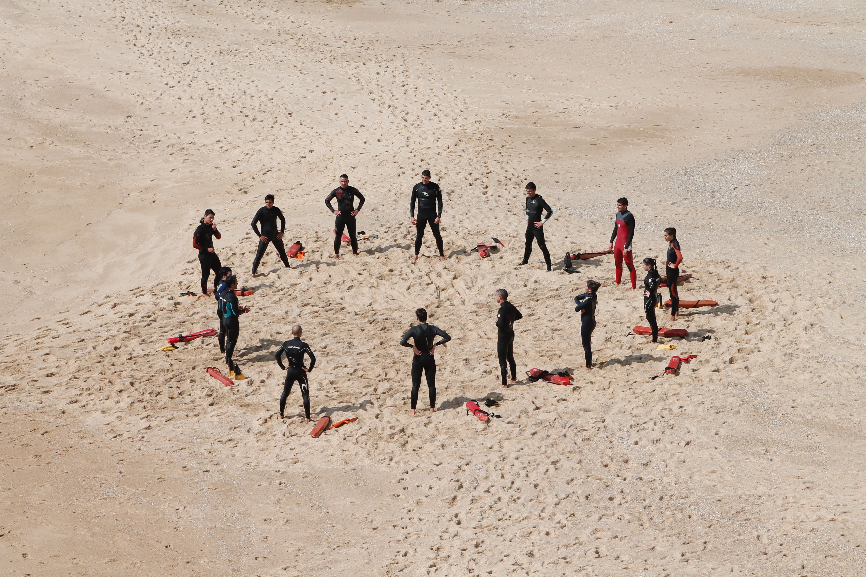
Ethics is a new way of deciding
Photo by Margarida CSilva on Unsplash

Slide 32
How to implement an ethics board
Key decision-making stakeholders
External representatives
Monthly meetings
Employee gateway
Build as a resource, not as governance
Define terms

Slide 33
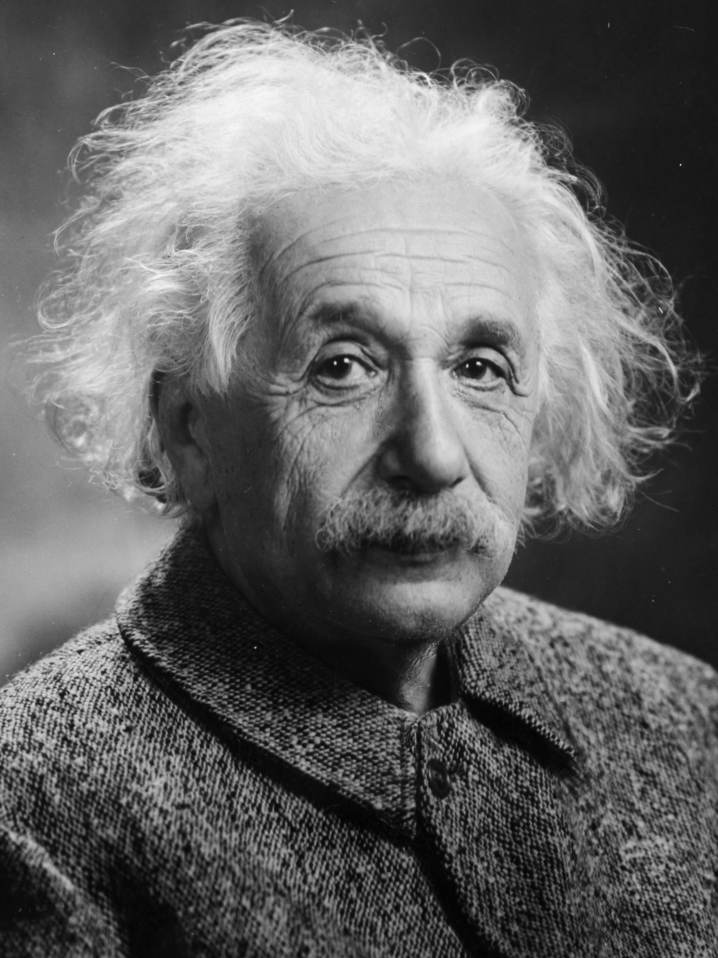
Reminder from Al
“If I had an hour to solve a problem I'd spend 55 minutes thinking about the problem and five minutes thinking about solutions.”
Continuously refine your questions

Slide 34
Practice saying ‘I don’t know’
Photo by Paolo Nicolello on Unsplash

Slide 35


John Sumser
Principal Analyst, HRExaminer
Intelligent Tools Columnist, HRExecutive Magazine
Selection/Implementation Consulting
Product Development
@johnsumser
John@hrexaminer.com

